Slide 1
22. Virtual Memory: Basics

Slide 2
Virtual Memory

Slide 3
Storage Hierarchy
done
Cache
(SRAM)
Cost
Latency
Main Memory
(DRAM)
today
Disk Storage
(Magnetic media)

Slide 4
Memory: the issues(s)
We run many programs on a same machine
Each of them may require GBs of storage
Unrelated programs must not have access to each other’s storage
DRAM is too expensive to buy 100s GB, but disk space is not…
We want our system to work even if it requires more DRAM than we bought.
We also don’t want a program that works on a machine with 2048 MB of DRAM to stop working if we try to run it on a machine with only 512 MB of main memory.
And, it would be nice to be able to enforce different policies on different portions of the memory (e.g.: read-only, etc)
Notes:
For single die, 8Gb-DRAM and 128Gb-FLASH are the largest.
(recently, 256Gb flash was announced. but mass-production has not been done yet)

Slide 5
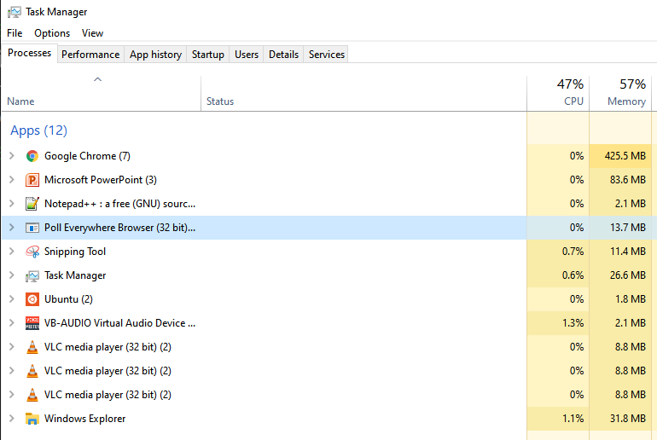
Memory: Two Issues
We've been working with the abstraction that all programs have full, private access to memory
But in practice, multiple programs run at the same time!
What happens if two programs try to write to the same memory address??

Slide 6
Memory: Two Issues
Even if only one program is running, modern computers have 48-64 bit address spaces!
No computer actually has 18 exabytes (18 billion GBs)
What if a computer tries to write to address 0xFFFF…FFFF
Should it just crash??

Slide 7
Memory: Two Issues
Modern systems use the same solution for both problems: virtual memory
In a nutshell, each program thinks it has full, private access to memory (it can safely index any address from 0x0-0xFFF…FFFF)
Hardware and software transparently maps these addresses to distinct addresses in DRAM and in hard disk
Focus for the next 2-3 lectures

Slide 8
(Aside: Virtual Memory Alternative)
Do we have to use virtual memory?
No, we could just leave the problem to the programmer
Assume the programmer knows the exact configuration of the machine.
Programmer must either make sure the program fits in memory, or break the program up into pieces that do fit and load each other off the disk when necessary
Not a bad solution in some domains
The hardware design is simple
(Original) PlayStation, engine control unit in a car, etc.
Systems with severe design constraints (e.g. RTOS)

Slide 9
Virtual memory
Build new hardware and software that automatically translates each memory reference from a virtual address (which the programmer sees as an array of bytes) to a
physical address (which the hardware uses to either index DRAM or identify where the storage resides on disk)

Slide 10
Virtual Memory

Slide 11
Basics of Virtual Memory
Any time you see the word virtual in computer science and architecture it means “using a level of indirection”.
Virtual memory hardware changes the virtual address the programmer sees into the physical one the memory chips see.
0x800
0x3C00
Disk ID 803C4
Virtual address
Physical address

Slide 12
Why Virtual Memory?
Virtual memory enables multiple programs to share the physical memory.
Provides following 3 capabilities to the programs:
Transparency
- Don’t need to know how other programs are using memory
Protection
- No program can modify the data of any other program
Programs not limited by DRAM capacity
- Each program can have more data than DRAM size

Slide 13
Revisit real system view—multitasking
Code
Code
Code
Physical
Memory
(DRAM)
Static Data
Static Data
...
Static Data
Heap Data
Heap Data
Heap Data
Stack
Stack
Stack
Processor
Smaller than the sum of all programs’ memory

Slide 14
Managing Virtual Memory—VM
Managed by hardware logic and operating system software.
Hardware for speed
Software for flexibility and because disk storage is controlled by the operating system
The hardware must be designed to support VM*
*(do not confuse VM for “Virtual Machine”, which is another concept entirely)

Slide 15
1. How to achieve transparency & protection?

Slide 16
1. How to achieve transparency & protection?

Slide 17
Virtual memory terminology
Divide memory in chunks of Pages (e.g., 4KB for x86)
Size of physical page = size of virtual page
A virtual address consists of
A virtual page number
A page offset field (low order bits of the address)
Virtual Page accesses that are not found in physical memory (DRAM) are called Page Faults
Virtual address
Virtual page number
Page offset
31
11
0
Physical address
Physical page number
Page offset
31
11
0

Slide 18
1. How to achieve transparency & protection?

Slide 19
Page Table
Contains address translation information i.e., virtual address ➔ physical address
Page tables are maintained by the operating system
Each process has its own page table
Page tables themselves are kept in memory by OS, and OS knows the physical address of the page tables
No address translation is required by the OS for accessing the page tables

Slide 20
Why pages?
Poll: Why not have mappings for each individual address (e.g. set page size to one byte)? (select all that apply)
Uses too much memory
Causes different programs to interfere with each other
Uses too much power
None of the above
Why have the idea of "pages"? Why not just have a mapping for each individual address?
Because then we would need a mapping entry for every single element of memory
The mapping data would take up as much space as the actual program data!

Slide 21
Virtual memory terminology
This looks a lot like partitioning a memory address for caching!
Block offset -> page offset
Tag -> page number
No set / line index… why?
Virtual page number
Page offset
31
11
0
Poll: Why no analogue of line/set index?
It's implicitly part of the page number
Virtual pages can be mapped to any physical page number
Physical memory is large enough to avoid that
Virtual memory isn't a cache

Slide 22
Page table components
The Page table register points to the beginning of the page table
Page table register
Virtual page number
Page offset
valid
Physical page number
1
Physical page number
Physical page number
Page offset

Slide 23
Page table components - Example
Virtual address = 0x000040F3
Page table register
0x00004
0x0F3
valid
Physical page number
1
0x020C0
0x020C0
0x0F3
Physical address = 0x020C00F3

Slide 24
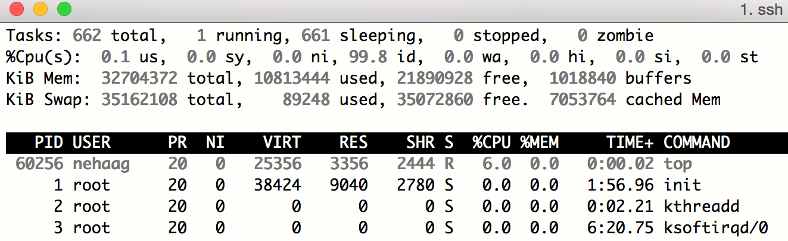
2. How to be not limited by DRAM capacity?
Use disk as temporary space in case memory capacity is exhausted
This temporary space in disk is called swap partition in Linux-based systems
For fun check swap space in a linux system by:
$: top

Slide 25
2. How to be not limited by DRAM capacity?
Page table for Chrome
0x0000
0x1000
0x5000
0x0000
0x1000
0x0000
DISK
0xF000
0x1A000
0x10000
Invalid
0x0000
0x1000
0x1F000
0x2000
0x1F000
0xF000
0x8000
DRAM
Program addresses
Page table for Word

Slide 26
Page faults
Page table register
0x00002
0x082
valid
Physical page number
0
Disk address
Exception: page fault
Stop this process
Pick page to replace
Write back data
Get referenced page
Update page table
Reschedule process

Slide 27
How do we find it on disk?
That is not a hardware problem! Go take EECS 482! ☺
This is the operating system’s job. Most operating systems partition the disk into logical devices (C: , D: , /home, etc.)
They also have a hidden partition to support the disk portion of virtual memory
Swap partition on UNIX machines
You then index into the correct page in the swap partition.

Slide 28
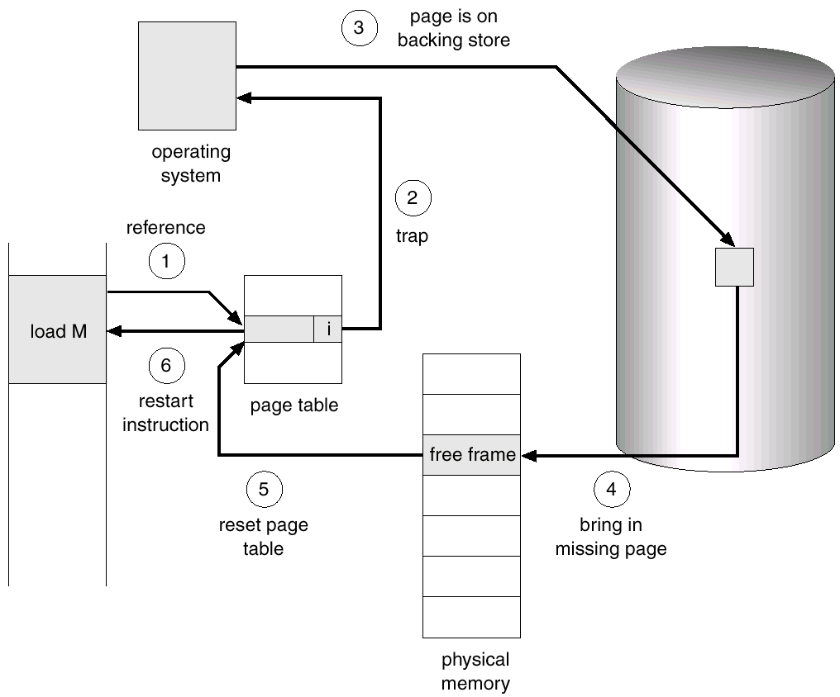
Page faults
Slide credit: Operating System Concepts
Silberschatz, Galvin and Gagne

Slide 29
Class Problem
Given the following:
4KB page size, physical memory of 16KB, page table stored in physical page 0 and can never be evicted, 20 bit, byte-addressable virtual address space.
The page table initially has virtual page 0 in physical page 1, virtual page 1 in physical page 2 and no valid data in other physical pages.
Fill in the table on the next slide for each reference
Note: like caches we’ll use LRU when we need to replace a page.

Slide 30
Class Problem (continued)
4KB page size,
physical memory of 16KB, page table stored in physical page 0 and can never be evicted, 20 bit, byte-addressable virtual address space.
The page table initially has virtual page 0 in physical page 1, virtual page 1 in physical page 2 and no valid data in other physical pages.
Virt addr | Virt page | Page fault? | Phys addr
0x00F0C
0x01F0C
0x20F0C
0x00100
0x00200
0x30000
0x01FFF
0x00200
Notes:
0x00F0C 0x0 N 0x1F0C

Slide 31
Class Problem (continued)
4KB page size,
physical memory of 16KB, page table stored in physical page 0 and can never be evicted, 20 bit, byte-addressable virtual address space.
The page table initially has virtual page 0 in physical page 1, virtual page 1 in physical page 2 and no valid data in other physical pages.
Virt addr | Virt page | Page fault? | Phys addr
0x00F0C | 0x0 | N | 0x1F0C
0x01F0C
0x20F0C
0x00100
0x00200
0x30000
0x01FFF
0x00200
Notes:
0x1 N 0x2F0C

Slide 32
Class Problem (continued)
4KB page size,
physical memory of 16KB, page table stored in physical page 0 and can never be evicted, 20 bit, byte-addressable virtual address space.
The page table initially has virtual page 0 in physical page 1, virtual page 1 in physical page 2 and no valid data in other physical pages.
Virt addr | Virt page | Page fault? | Phys addr
0x00F0C | 0x0 | N | 0x1F0C
0x01F0C | 0x1 | N | 0x2F0C
0x20F0C
0x00100
0x00200
0x30000
0x01FFF
0x00200
Notes:
0x01F0C 0x20 Y (into 3) 0x3F0C

Slide 33
Class Problem (continued)
4KB page size,
physical memory of 16KB, page table stored in physical page 0 and can never be evicted, 20 bit, byte-addressable virtual address space.
The page table initially has virtual page 0 in physical page 1, virtual page 1 in physical page 2 and no valid data in other physical pages.
Virt addr | Virt page | Page fault? | Phys addr
0x00F0C | 0x0 | N | 0x1F0C
0x01F0C | 0x1 | N | 0x2F0C
0x20F0C | 0x20 | Y (into 3) | 0x3F0C
0x00100
0x00200
0x30000
0x01FFF
0x00200
Poll: How many page faults will there be?
1
2
3
4

Slide 34
Class Problem (continued)
4KB page size,
physical memory of 16KB, page table stored in physical page 0 and can never be evicted, 20 bit, byte-addressable virtual address space.
The page table initially has virtual page 0 in physical page 1, virtual page 1 in physical page 2 and no valid data in other physical pages.
Virt addr | Virt page | Page fault? | Phys addr
0x00F0C | 0x0 | N | 0x1F0C
0x01F0C | 0x1 | N | 0x2F0C
0x20F0C | 0x20 | Y (into 3) | 0x3F0C
0x00100 | 0x0 | N | 0x1100
0x00200 | 0x0 | N | 0x1200
0x30000 | 0x30 | Y (into 2) | 0x2000
0x01FFF | 0x1 | Y (into 3) | 0x3FFF
0x00200 | 0x0 | N | 0x1200

